Slide 1
Using signals🚦
Boost your signals game 🎮

Slide 2
🤔 Initial value dilemma

Slide 3
Initial value dilemma 🤔
⚠️ Signals require an initial value!

Slide 4
Initial value dilemma 🤔
It’s easy to provide an initial value (if we don’t know it) for:
Booleans -> signal(false);
Arrays -> signal<Movie[]>([]);
Strings -> signal(‘’);
Numbers -> signal(0);
What about Objects?
⚠️ Signals require an initial value!

Slide 5
Initial value dilemma 🤔
It’s easy to provide an initial value (if we don’t know it) for:
Booleans -> signal(false);
Arrays -> signal<Movie[]>([]);
Strings -> signal(‘’);
Numbers -> signal(0);
What about Objects?
⚠️ Signals require an initial value!
⚠️ If they are not ID-s, otherwise null is better.

Slide 6
Initial value dilemma about objects 🤔
Let’s take a movie signal as an example.
movie = signal<Movie>({} as Movie);
movie = signal<Partial<Movie>>({});
movie = signal<Movie | null>(null);
movie = signal<Movie | undefined>(undefined);

Slide 7
Initial value dilemma about objects 🤔 ({} as Movie)
movie = signal<Movie>({} as Movie);
// TS Usage
onClick() {
this.service.doSomething(this.movie().id);
}
// Template usage
<movie-header [title]="movie().title" />

Slide 8
Initial value dilemma about objects 🤔 ({} as Movie)
movie = signal<Movie>({} as Movie);
// TS Usage
onClick() {
this.service.doSomething(this.movie().id);
}
// Template usage
<movie-header [title]="movie().title" />
id can be undefined, but Typescript will not complain, so we need to check for undefined

Slide 9
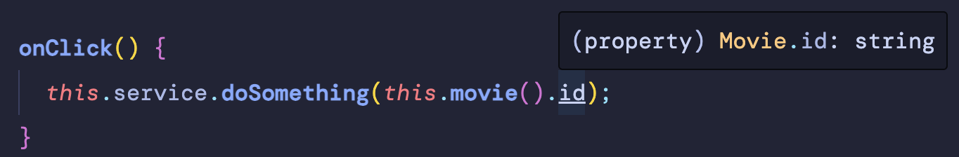
Initial value dilemma about objects 🤔 ({} as Movie)
movie = signal<Movie>({} as Movie);
// TS Usage
onClick() {
this.service.doSomething(this.movie().id);
}
// Template usage
<movie-header [title]="movie().title" />
id can be undefined, but Typescript will not complain, so we need to check for undefined

Slide 10
Initial value dilemma about objects 🤔 (Partial<Movie>)
movie = signal<Partial<Movie>>({});
onClick() {
this.service.doSomething(this.movie().id);
}
<movie-header [title]="movie().title" />
Every field of the movie object will be also undefined.
Bad DX when we know that the object can have all these fields if populated.

Slide 11
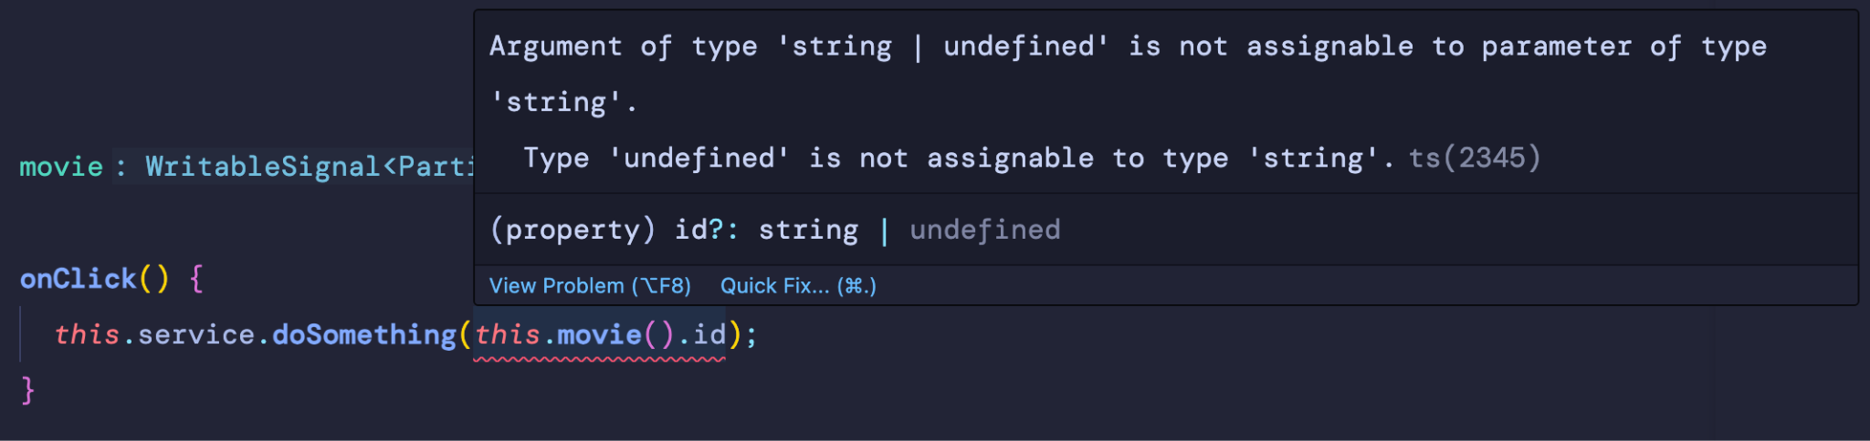
Initial value dilemma about objects 🤔 (Partial<Movie>)
movie = signal<Partial<Movie>>({});
onClick() {
this.service.doSomething(this.movie().id);
}
<movie-header [title]="movie().title" />
Every field of the movie object will be also undefined.
Bad DX when we know that the object can have all these fields if populated.

Slide 12
Initial value dilemma about objects 🤔 (Movie | null)
movie = signal<Movie | null>(null);
✅ Explicit null!

Slide 13
Initial value dilemma about objects 🤔 (Movie | null)
movie = signal<Movie | null>(null);
onClick() {
if (this.movie()) {
this.service.doSomething(this.movie().id);
}
}

Slide 14
⚠️ Function call issues

Slide 15
Initial value dilemma about objects 🤔 (Movie | null)
movie = signal<Movie | null>(null);
onClick() {
if (this.movie()) {
this.service.doSomething(this.movie().id);
}
}
<movie-header *ngIf="movie()" [title]="movie().title" />

Slide 16
Initial value dilemma about objects 🤔 (Movie | null)
movie = signal<Movie | null>(null);
onClick() {
if (this.movie()) {
this.service.doSomething(this.movie().id);
}
}
<movie-header *ngIf="movie()" [title]="movie().title" />
Type narrowing doesn’t work on function calls!

Slide 17
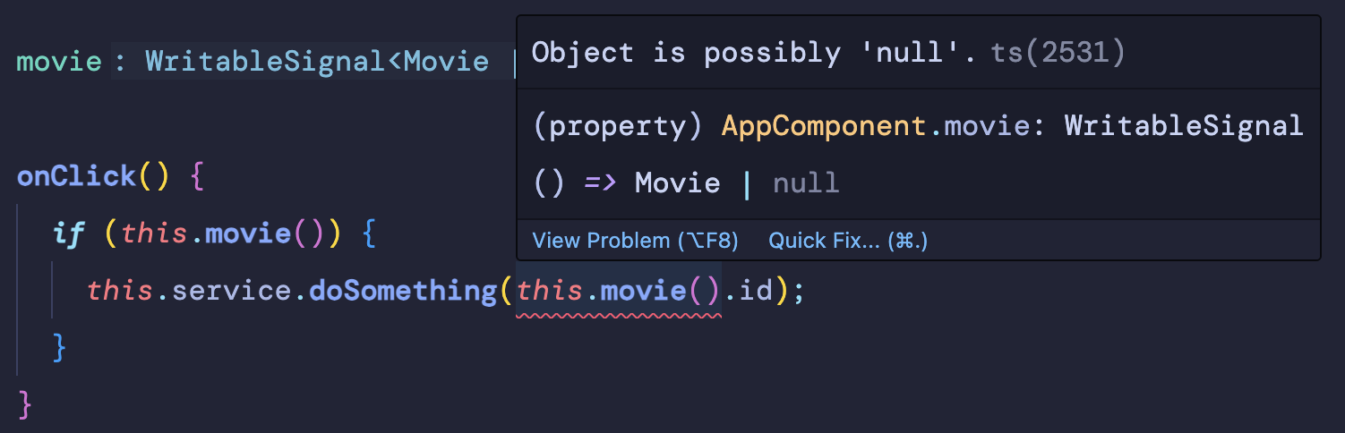
Initial value dilemma about objects 🤔 (Movie | null)
movie = signal<Movie | null>(null);
onClick() {
if (this.movie()) {
this.service.doSomething(this.movie().id);
}
}
<movie-header *ngIf="movie()" [title]="movie().title" />
Type narrowing doesn’t work on function calls!

Slide 18
Initial value dilemma about objects 🤔 (Movie | null)
movie = signal<Movie | null>(null);
onClick() {
if (this.movie()) {
this.service.doSomething(this.movie().id);
}
}
<movie-header *ngIf="movie()" [title]="movie().title" />

Slide 19
✅ Store the signal value into a variable
movie = signal<Movie | null>(null);
onClick() {
const movie = this.movie();
if (movie) {
this.service.doSomething(movie.id);
}
}
<movie-header *ngIf="movie() as movie" [title]="movie.title" />
Explicit null check!
No surprises 🎉!
Using ‘as’ solves the issue in the template 🎉!

Slide 20

Demo & Exercise Time!
Signal introduction

Slide 21
🪄 computed() tricks
Dynamic dependencies & Auto memoization

Slide 22
Branching in Computations (Dynamic deps)
const showName = signal(false);
Notes:
Computed signals keep track of which signals were read in their computations, in order to know when recomputation is necessary.
This dependency set is dynamic, and self-adjusts with each computation.

Slide 23
Branching in Computations (Dynamic deps)
const showName = signal(false);
const greeting = computed(() => {
if (showName()) {
return `Hello, ${name()}!`;
}
return 'Hello!';
});
greeting();
Notes:
Computed signals keep track of which signals were read in their computations, in order to know when recomputation is necessary.
This dependency set is dynamic, and self-adjusts with each computation.

Slide 24
Branching in Computations (Dynamic deps)
const showName = signal(false);
const greeting = computed(() => {
if (showName()) {
return `Hello, ${name()}!`;
}
return 'Hello!';
});
greeting();
Deps list
showName() === false
👇
[showName]

Slide 25
Branching in Computations (Dynamic deps)
const showName = signal(true);
const greeting = computed(() => {
if (showName()) {
return `Hello, ${name()}!`;
}
return 'Hello!';
});
greeting();
Deps list
showName() === false
👇
[showName]
👇
showName() === true
[showName, name]

Slide 26
Don’t break computed
const showName = false; // normal boolean

Slide 27
Don’t break computed
const showName = false; // normal boolean
const greeting = computed(() => {
if (showName) {
return `Hello, ${name()}!`;
}
return 'Hello!';
});
greeting();

Slide 28
Don’t break computed
const showName = false; // normal boolean
const greeting = computed(() => {
if (showName) {
return `Hello, ${name()}!`;
}
return 'Hello!';
});
greeting();
Deps list
showName === false
⚠️
[]

Slide 29
Don’t break computed
const showName = false; // normal boolean
const greeting = computed(() => {
if (showName) {
return `Hello, ${name()}!`;
}
return 'Hello!';
});
greeting();
Deps list
showName === false
⚠️
[]
Broken State

Slide 30
Don’t break computed
const showName = false; // normal boolean
const greeting = computed(() => {
if (showName) {
return `Hello, ${name()}!`;
}
return 'Hello!';
});
greeting();
Deps list
showName === false
⚠️
[]
Broken State
👇

Slide 31
Don’t break computed
const showName = false; // normal boolean
const greeting = computed(() => {
if (showName) {
return `Hello, ${name()}!`;
}
return 'Hello!';
});
greeting();
Deps list
showName === false
⚠️
[]
Broken State
👇
Always make sure to branch out using signal fn calls and not static values, as you can break the computed computation.

Slide 32
Possible solution 🧪
const showName = false; // normal boolean
const greeting = computed(() => {
const name = name();
if (showName) {
return `Hello, ${name}!`;
}
return 'Hello!';
});
greeting();
Deps list
showName === false
👇
[name]

Slide 33
Possible solution 🧪
const showName = false; // normal boolean
const greeting = computed(() => {
const name = name();
if (showName) {
return `Hello, ${name}!`;
}
return 'Hello!';
});
greeting();
Deps list
showName === false
👇
[name]
Store the signal value into a variable before you use them into any conditional logic!

Slide 34
What about auto-memoization?

Slide 35
What about auto-memoization?
function heavyComputation(data: DataOptions[]) {
...
}

Slide 36
What about auto-memoization?
function heavyComputation(data: DataOptions[]) {
...
}
dataOptions = computed(() => heavyComputation(this.dataOptions));

Slide 37
What about auto-memoization?
function heavyComputation(data: DataOptions[]) {
...
}
dataOptions = computed(() => heavyComputation(this.dataOptions));
0 signal reads

Slide 38
What about auto-memoization?
function heavyComputation(data: DataOptions[]) {
...
}
dataOptions = computed(() => heavyComputation(this.dataOptions));
0 signal reads
USE WITH CAUTION:
We can use computed as a auto-memoization helper! Because we don’t use any signals inside of it, it will run only once!

Slide 39
Demo & Exercise Time!
Computed

Slide 40
📥 Signal Inputs

Slide 41
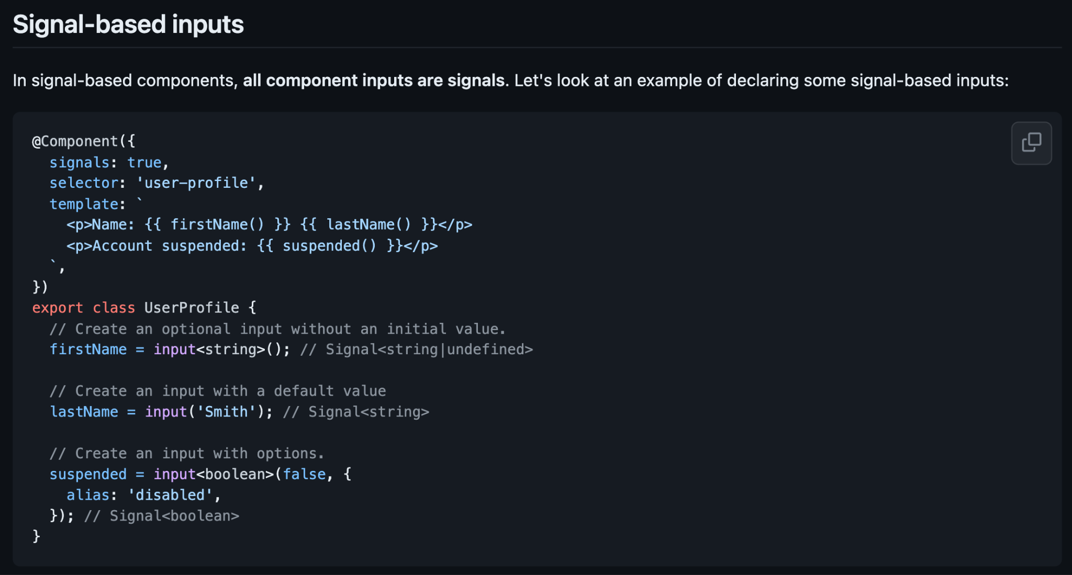
Signal-based Components Angular RFC

Slide 42
Signal-based Components Angular RFC

Slide 43
Signal Inputs got released 🎉
// definition
interface InputSignal<ReadT, WriteT = ReadT> extends Signal<ReadT> {}
// usage
readonly firstName = input<string | null>(null);
// old
@Input() firstName: string | null = null;

Slide 44
Good news!

Slide 45
Signal Inputs won’t suffer from initial value dilemma! 🎉

Slide 46
Signal Inputs won’t suffer from initial value dilemma! 🎉
readonly firstName = input(); // InputSignal<undefined | undefined>
readonly firstName = input<string>(); // InputSignal<string | undefined>
readonly firstName = input<string>(‘’); // InputSignal<string | string>
readonly firstName = input(‘’); // InputSignal<string>
readonly firstName = input.required(); // InputSignal<unknown | unknown>
readonly firstName = input.required<string>(); // InputSignal<string>
readonly firstName = input.required({
initialValue: ‘’,
}); // InputSignal<string | string>
👉

Slide 47
Signal Inputs won’t suffer from initial value dilemma! 🎉
readonly firstName = input(); // InputSignal<undefined | undefined>
readonly firstName = input<string>(); // InputSignal<string | undefined>
readonly firstName = input<string>(‘’); // InputSignal<string | string>
readonly firstName = input(‘’); // InputSignal<string>
readonly firstName = input.required(); // InputSignal<unknown | unknown>
readonly firstName = input.required<string>(); // InputSignal<string>
readonly firstName = input.required({
initialValue: ‘’,
}); // InputSignal<string | string>
👉

Slide 48
Signal Inputs won’t suffer from initial value dilemma! 🎉
readonly firstName = input(); // InputSignal<undefined | undefined>
readonly firstName = input<string>(); // InputSignal<string | undefined>
readonly firstName = input<string>(‘’); // InputSignal<string | string>
readonly firstName = input(‘’); // InputSignal<string>
readonly firstName = input.required(); // InputSignal<unknown | unknown>
readonly firstName = input.required<string>(); // InputSignal<string>
readonly firstName = input.required({
initialValue: ‘’,
}); // InputSignal<string | string>
👉

Slide 49
Signal Inputs won’t suffer from initial value dilemma! 🎉
readonly firstName = input(); // InputSignal<undefined | undefined>
readonly firstName = input<string>(); // InputSignal<string | undefined>
readonly firstName = input<string>(‘’); // InputSignal<string | string>
readonly firstName = input(‘’); // InputSignal<string>
readonly firstName = input.required(); // InputSignal<unknown | unknown>
readonly firstName = input.required<string>(); // InputSignal<string>
readonly firstName = input.required({
initialValue: ‘’,
}); // InputSignal<string | string>
👉

Slide 50
Signal Inputs won’t suffer from initial value dilemma! 🎉
readonly firstName = input(); // InputSignal<undefined | undefined>
readonly firstName = input<string>(); // InputSignal<string | undefined>
readonly firstName = input<string>(‘’); // InputSignal<string | string>
readonly firstName = input(‘’); // InputSignal<string>
readonly firstName = input.required(); // InputSignal<unknown | unknown>
readonly firstName = input.required<string>(); // InputSignal<string>
readonly firstName = input.required({
initialValue: ‘’,
}); // InputSignal<string | string>
👉

Slide 51
Signal Inputs won’t suffer from initial value dilemma! 🎉
readonly firstName = input(); // InputSignal<undefined | undefined>
readonly firstName = input<string>(); // InputSignal<string | undefined>
readonly firstName = input<string>(‘’); // InputSignal<string | string>
readonly firstName = input(‘’); // InputSignal<string>
readonly firstName = input.required(); // InputSignal<unknown | unknown>
readonly firstName = input.required<string>(); // InputSignal<string>
readonly firstName = input.required({
initialValue: ‘’,
}); // InputSignal<string | string>
👉

Slide 52
Signal Inputs won’t suffer from initial value dilemma! 🎉
readonly firstName = input(); // InputSignal<undefined | undefined>
readonly firstName = input<string>(); // InputSignal<string | undefined>
readonly firstName = input<string>(‘’); // InputSignal<string | string>
readonly firstName = input(‘’); // InputSignal<string>
readonly firstName = input.required(); // InputSignal<unknown | unknown>
readonly firstName = input.required<string>(); // InputSignal<string>
readonly firstName = input.required({
initialValue: ‘’,
}); // InputSignal<string | string>
👉

Slide 53
Signal Inputs won’t suffer from initial value dilemma! 🎉
readonly firstName = input(); // InputSignal<undefined | undefined>
readonly firstName = input<string>(); // InputSignal<string | undefined>
readonly firstName = input<string>(‘’); // InputSignal<string | string>
readonly firstName = input(‘’); // InputSignal<string>
readonly firstName = input.required(); // InputSignal<unknown | unknown>
readonly firstName = input.required<string>(); // InputSignal<string>
readonly firstName = input.required({
initialValue: ‘’,
}); // InputSignal<string | string>
🎉

Slide 54
👻 effect() gotchas

Slide 55
We are told that:
effect callback function runs every time the signals inside of it change
effect runs at least once by default

Slide 56
We are told that:
effect callback function runs every time the signals inside of it change
effect runs at least once by default

Slide 57
We are told that:
effect callback function runs every time the signals inside of it change
effect runs at least once by default

Slide 58
We are told that:
effect callback function runs every time the signals inside of it change
effect runs at least once by default
const movie = signal<Movie | null>(null);
effect(() => console.log('data', this.movie()));
movie.set({ title: 'Interstellar', rating: 10 });
movie.set({ title: 'Inception', rating: 10 });
💡

Slide 59
We are told that:
effect callback function runs every time the signals inside of it change
effect runs at least once by default
const movie = signal<Movie | null>(null);
effect(() => console.log('data', this.movie()));
movie.set({ title: 'Interstellar', rating: 10 });
movie.set({ title: 'Inception', rating: 10 });
💡
👇

Slide 60
What’s going to be logged in the console 🤔:
const movie = signal<Movie | null>(null);
effect(() => console.log('data', this.movie()));
movie.set({ title: 'Interstellar', rating: 10 });
movie.set({ title: 'Inception', rating: 10 });
null
Interstellar
Inception
Interstellar
Inception
Inception

Slide 61
What’s going to be logged in the console 🤔:
const movie = signal<Movie | null>(null);
effect(() => console.log('data', this.movie()));
movie.set({ title: 'Interstellar', rating: 10 });
movie.set({ title: 'Inception', rating: 10 });
👇
null
Interstellar
Inception
Interstellar
Inception
Inception

Slide 62
What’s going to be logged in the console 🤔:
const movie = signal<Movie | null>(null);
effect(() => console.log('data', this.movie()));
movie.set({ title: 'Interstellar', rating: 10 });
movie.set({ title: 'Inception', rating: 10 });
👇
null
Interstellar
Inception
Interstellar
Inception
Inception

Slide 63
What’s going to be logged in the console 🤔:
const movie = signal<Movie | null>(null);
effect(() => console.log('data', this.movie()));
movie.set({ title: 'Interstellar', rating: 10 });
movie.set({ title: 'Inception', rating: 10 });
👇
null
Interstellar
Inception
Interstellar
Inception
Inception

Slide 64
Think about it! 💡

Slide 65
What’s going to be logged in the console 🤔:
const movie = signal<Movie | null>(null);
effect(() => console.log('data', this.movie()));
movie.set({ title: 'Interstellar', rating: 10 });
movie.set({ title: 'Inception', rating: 10 });
null
Interstellar
Inception
Interstellar
Inception
Inception

Slide 66
What’s going to be logged in the console 🤔:
const movie = signal<Movie | null>(null);
effect(() => console.log('data', this.movie()));
movie.set({ title: 'Interstellar', rating: 10 });
movie.set({ title: 'Inception', rating: 10 });
👇
🎉
null
Interstellar
Inception
Interstellar
Inception
Inception

Slide 67
Effects are scheduled via the microtask queue!

Slide 68
Demo & Exercise Time!
Effect Introduction

Slide 69
🦾 Reactive Hostbinding using signals
Move after toSignal

Slide 70
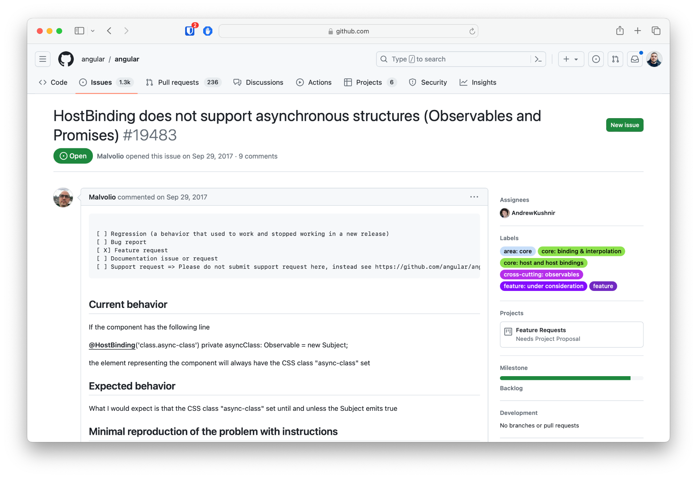
🦾 Reactive Hostbinding using signals
Move after toSignal
https://github.com/angular/angular/issues/19483

Slide 71
Use signals to reactively change host bindings
@Directive({
selector: '[testCss]',
host: {
'[class.myTestCss]': 'test()'
}
})
export class TestDirective {
readonly isTest$ = new Subject<boolean>();
test = toSignal(this.isTest$, { initialValue: false });
}
https://github.com/angular/angular/issues/19483

Slide 72
🚦 Single signals/computed over signal object

Slide 73
🚦 Single signals/computed over signal object
When signal components get released, we will be able to only re-render the templates which signals have changed.

Slide 74
🚦 Single signals/computed over signal object
When signal components get released, we will be able to only re-render the templates which signals have changed.
<movie-filters [(filter)]="state.filters" />
@if (state.loading()) {
<div>Loading...</div>
} @else if (state.error()) {
<div>Error: {{ state.error() }}</div>
} @else {
<movies-list [movies]="state.movies()" />
}

Slide 75
🚦 Single signals/computed over signal object
When signal components get released, we will be able to only re-render the templates which signals have changed.
<movie-filters [(filter)]="state.filters" />
@if (state.loading()) {
<div>Loading...</div>
} @else if (state.error()) {
<div>Error: {{ state.error() }}</div>
} @else {
<movies-list [movies]="state.movies()" />
}

Slide 76
🚦 Single signals/computed over signal object
const loading = signal(false);
const error = signal(null);
const data = signal([] as Movie[]);
const filters = signal({ title: '' });
const state = {
loading: signal(false),
error: signal(null),
data: signal([] as Movie[]),
filters: signal({ title: '' }),
};
const stateObject = signal({
loading: false,
error: null,
data: [] as Movie[],
filters: { title: '' },
});

Slide 77
🚦 Single signals/computed over signal object
const loading = signal(false);
const error = signal(null);
const data = signal([] as Movie[]);
const filters = signal({ title: '' });
const state = {
loading: signal(false),
error: signal(null),
data: signal([] as Movie[]),
filters: signal({ title: '' }),
};
const stateObject = signal({
loading: false,
error: null,
data: [] as Movie[],
filters: { title: '' },
});
@if (loading()) {
<div>Loading...</div>
} @else if (error()) {
<div>Error: {{error() }}</div>
} @else {
<movies-list [movies]="movies()" />
}

Slide 78
🚦 Single signals/computed over signal object
const loading = signal(false);
const error = signal(null);
const data = signal([] as Movie[]);
const filters = signal({ title: '' });
const state = {
loading: signal(false),
error: signal(null),
data: signal([] as Movie[]),
filters: signal({ title: '' }),
};
const stateObject = signal({
loading: false,
error: null,
data: [] as Movie[],
filters: { title: '' },
});
@if (state.loading()) {
<div>Loading...</div>
} @else if (state.error()) {
<div>Error: {{ state.error() }}</div>
} @else {
<movies-list [movies]="state.movies()" />
}

Slide 79
🚦 Single signals/computed over signal object
const loading = signal(false);
const error = signal(null);
const data = signal([] as Movie[]);
const filters = signal({ title: '' });
const state = {
loading: signal(false),
error: signal(null),
data: signal([] as Movie[]),
filters: signal({ title: '' }),
};
const stateObject = signal({
loading: false,
error: null,
data: [] as Movie[],
filters: { title: '' },
});
@if (state().loading) {
<div>Loading...</div>
} @else if (state().error) {
<div>Error: {{ state().error }}</div>
} @else {
<movies-list [movies]="state().movies" />
}

Slide 80
🚦 Single signals/computed over signal object
const loading = signal(false);
const error = signal(null);
const data = signal([] as Movie[]);
const filters = signal({ title: '' });
const state = {
loading: signal(false),
error: signal(null),
data: signal([] as Movie[]),
filters: signal({ title: '' }),
};
const stateObject = signal({
loading: false,
error: null,
data: [] as Movie[],
filters: { title: '' },
});
👎
@if (state().loading) {
<div>Loading...</div>
} @else if (state().error) {
<div>Error: {{ state().error }}</div>
} @else {
<movies-list [movies]="state().movies" />
}

